Slide 1
Feture Selection summary – before noralization & standardization
● : seleted
 |  | RFE | Reg
temp | 평균기온(°C) | ● | ●
l_temp | 최저기온(°C) | ● | ●
h_temp | 최고기온(°C) |  | ●
rain_per_day | 일강수량(mm)
wind | 평균 풍속(m/s) | ●
dew | 평균 이슬점온도(°C)
humidity | 평균 상대습도(%)
steam_pressure | 평균 증기압(hPa)
sunshine_time | 합계 일조시간(hr)
sunshine | 합계 일사량(MJ/m2)
ground_surface_temp | 평균 지면온도(°C) | ● | ●

Slide 2
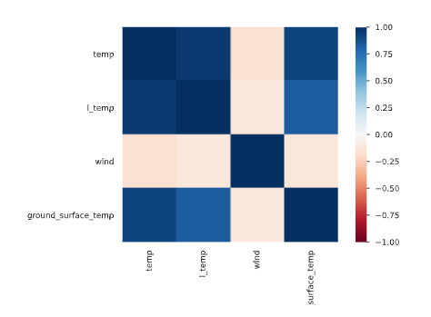
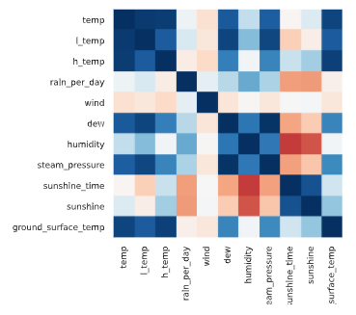
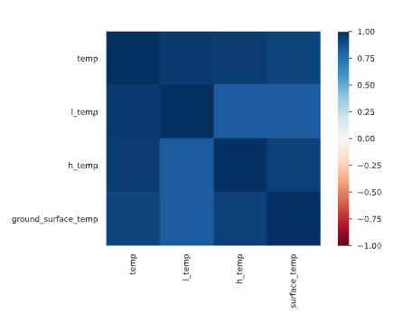
Feture Selection summary
Data without mutate variable
RFE
REG

Slide 3
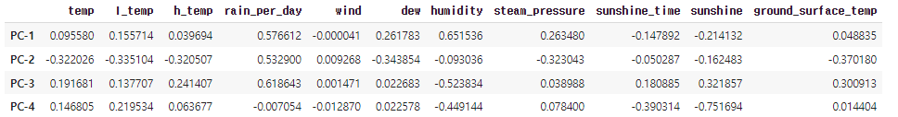
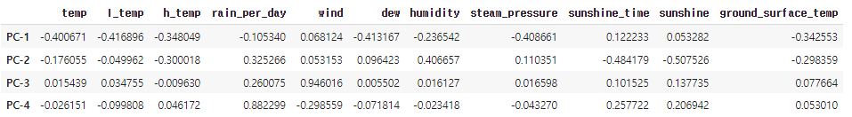
PCA before normalization & standardization
PCA after normalization & standardization

Slide 4
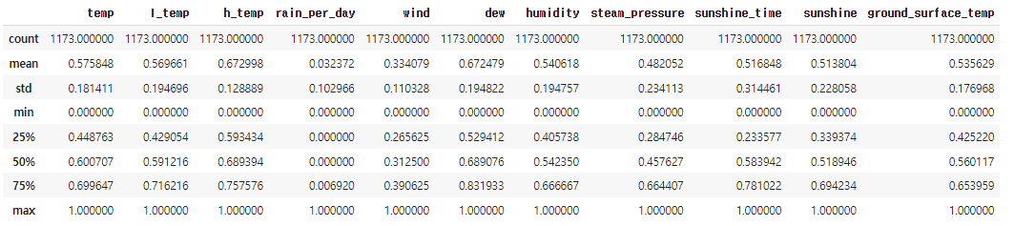
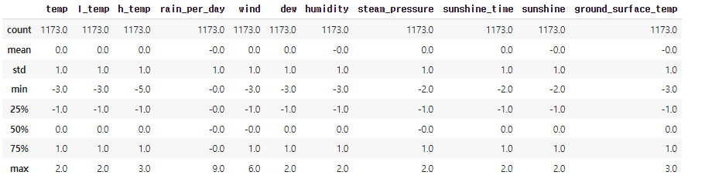
Normalization & standardization
Normalization
standardization

Slide 5
Feture Selection summary – After noralization & standardization
● : seleted
 |  | RFE | Reg
temp | 평균기온(°C) | ● | ●
l_temp | 최저기온(°C) | ● | ●
h_temp | 최고기온(°C) |  | ●
rain_per_day | 일강수량(mm)
wind | 평균 풍속(m/s)
dew | 평균 이슬점온도(°C) | ●
humidity | 평균 상대습도(%)
steam_pressure | 평균 증기압(hPa)
sunshine_time | 합계 일조시간(hr)
sunshine | 합계 일사량(MJ/m2)
ground_surface_temp | 평균 지면온도(°C) | ● | ●

Slide 6
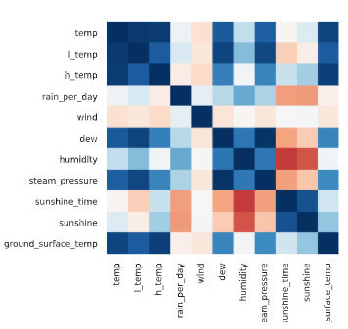
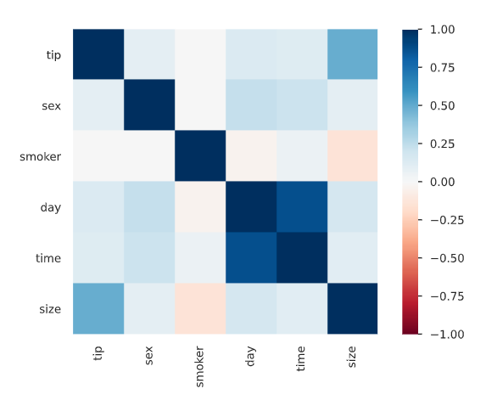
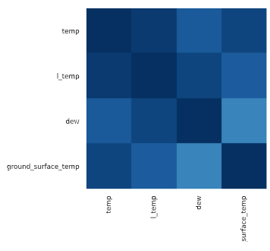
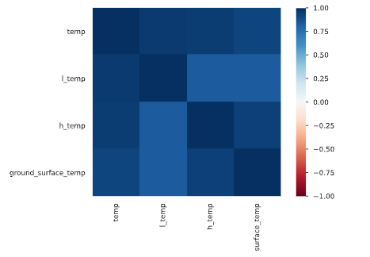
Feture Selection summary – After noralization & standardization
Data without mutate variable
RFE
REG

